Slide 1
8-Bit Load-Enable Register
Using D Flip-Flops
Muddana Raghuram Chowdary – 2620040111
M Sri Akhil Chowdary – 2620040110
R. Chandra Shekar - 2620040113

Slide 2
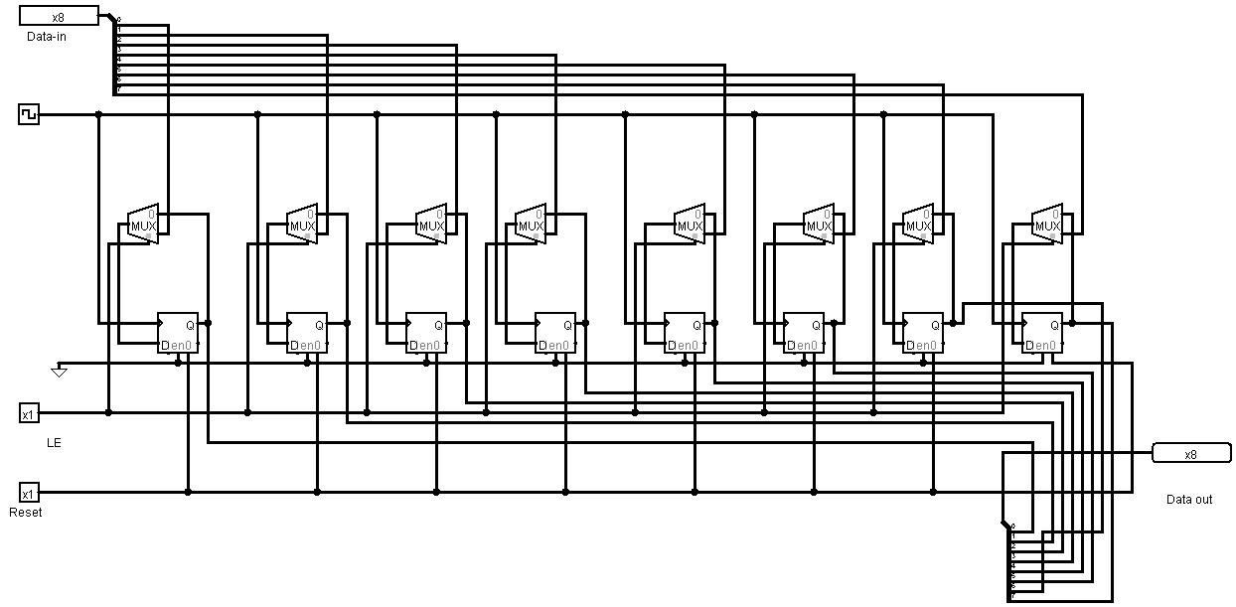

Slide 3
Working Principle
Bit-by-Bit Isolation: The register separates an 8-bit byte into 8 single bits. Each individual bit is controlled by one MUX and stored by one D Flip-Flop.
The Control Gate (MUX): The 2-to-1 Multiplexer acts as a switch in front of the Flip-Flop. It uses the Load signal to choose between two paths:
  When Load = 0 (Hold): The MUX selects the Flip-Flop’s own current output (\(Q\)) and routes it back into its input (\(D\)). The data endlessly loops and stays frozen.
  When Load = 1 (Load): The MUX opens the gate to the external input wire (\(Data\_In\)), dropping the old data and preparing to receive the new bit.
Synchronized Storage (Clock): When the clock ticks (Rising Edge), all 8 D Flip-Flops read their inputs at the exact same fraction of a second. This ensures the entire byte updates perfectly in sync.
Master Flush (Reset): The asynchronous reset line bypasses the MUX and the Clock entirely. Activating it instantly forces all 8 outputs to 00000000.

Slide 4
System Components & Architecture
• Core Structure: 8 individual D Flip-Flops side by side. Each acts as a 1-bit memory cell to collectively form a unified 8-bit storage register (Bit 0 [LSB] to Bit 7 [MSB]).
• Gating Multiplexers: 8 individual 2-to-1 Multiplexers (MUX) with 'Data Bits: 1' and 'Select Bits: 1' placed directly upstream of each flip-flop's D input port.
• Synchronous Clock Bus: A single global clock line shared symmetrically across all 8 flip-flop CLK pins to ensure unified, race-free parallel data updates.
• Asynchronous Control Line: A shared global master Reset wire tied to the asynchronous Clear pin of all 8 components for immediate state flushing.

Slide 5
Circuit Functional Modes
► HOLD MODE (Load = 0):
The 2-to-1 MUX selects Input 0, which is hardwired to its corresponding flip-flop's own current output (Q). This forms an active feedback loop. On every clock tick, the cell reads and overwrites its own state, ignoring changes on the main data input bus.
► LOAD MODE (Load = 1):
The MUX selects Input 1, breaking the feedback loop. This passes the external Data_In bit straight into the D input port. On the next rising edge of the clock signal, the newly applied external byte is instantly written to the register memory.
► ASYNCHRONOUS RESET (Reset = 1):
Flipping the reset switch instantly overrides all input conditions, the MUX selections, and clock cycles, dropping all stored outputs immediately to 00000000.

Slide 6
Operational States & Variable Combinations
Reset Pin | Load Pin | Clock (CLK) | Input Bus (Data_In) | Output Bus (Data_Out) | Active Mode Description
1 | X | X | XXXXXXXX (Any) | 00000000 | Asynchronous Reset: Wipes memory instantly
0 | 0 | ↑ (Rising Edge) | 10101010 | Previous State (Unchanged) | Hold State: MUX recycles current Q value
0 | 1 | ↑ (Rising Edge) | 10101010 | 10101010 | Load State: External byte written to memory
0 | X | 0 or 1 (Static) | 11110000 | Previous State (Unchanged) | No Clock Event: Changes on inputs ignored

Slide 7
Real Life Applications
CPU Internal Storage: Holds temporary math results and instruction codes inside processors.
Hardware State Machines: Memorises the current status of traffic lights and automated industrial machines.
Data Bus Buffering: Acts as a temporary staging area for data sent to keyboards and printers.
High-Speed Cache (SRAM): Serves as the core building block for fast, volatile computer memory.
Digital Signal Processing: Captures and holds audio or video samples for step-by-step editing

